Slide 1
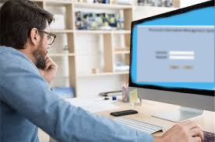
Phase 3 - Overall Development and Progress Report

Slide 2
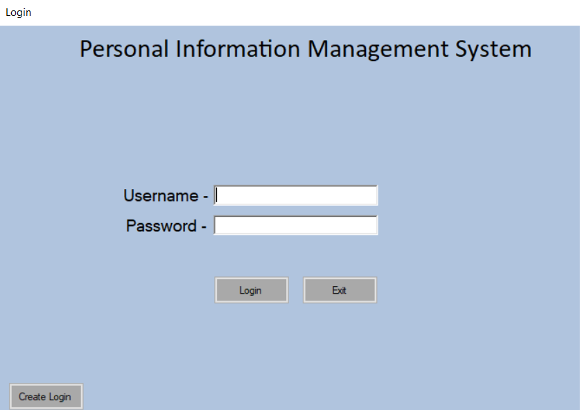
Login screen
Easy for the user to read and navigate
Buttons show clear representation of how they function
Colour scheming is in a professional manner

Slide 3
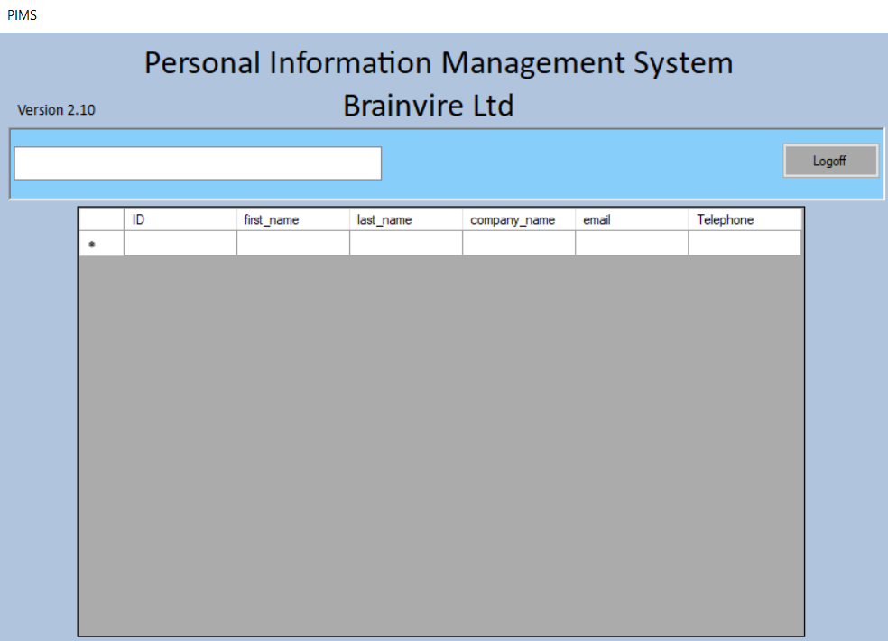
User View
Simple but effective view
Logoff clearly illustrated
Datagrid view will show the user the specified data from database
Some data is inaccessible for the user due to permissions (admin(1), user(2))

Slide 4
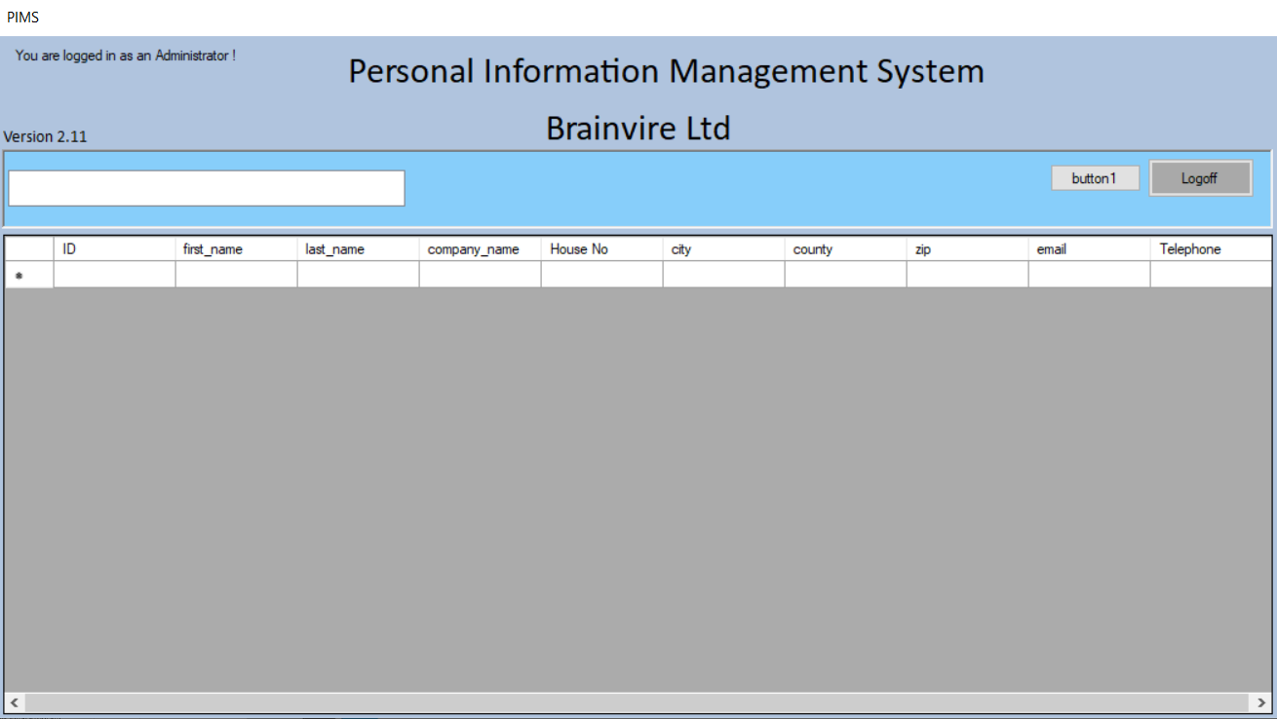
Administrator view
Simple but effective view
Logoff clearly illustrated
Datagrid view will show the user the specified data from database
Admin gets access to more sensitive information due to permissions

Slide 5
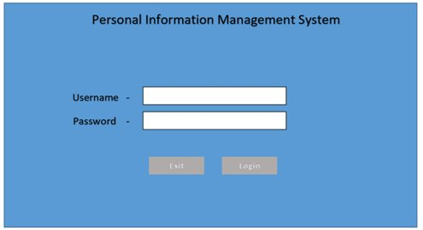
Login screen: Design vs Final Program

Slide 6
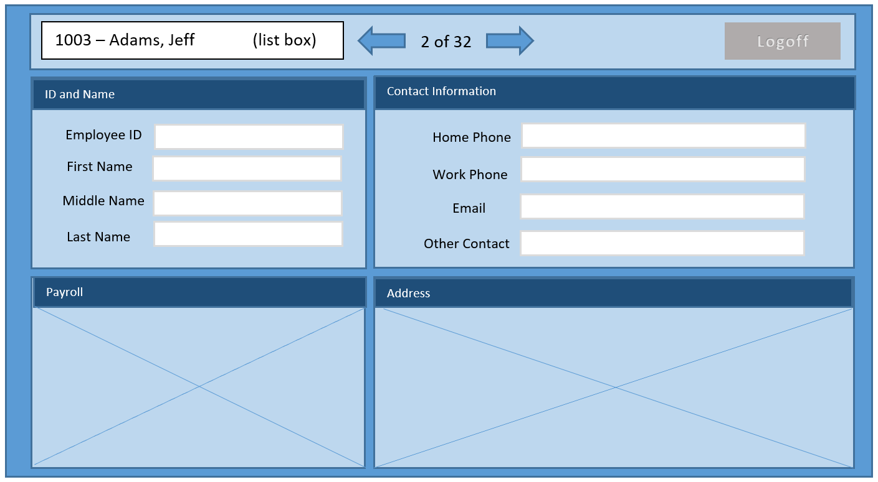
User view: Design vs Final Program

Slide 7
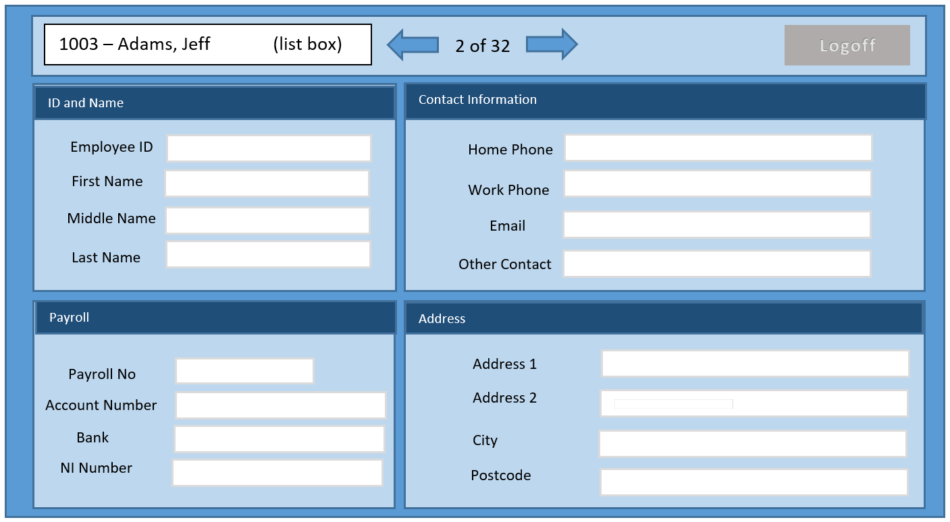
Administrator view: Design vs Final Program

